Slide 1
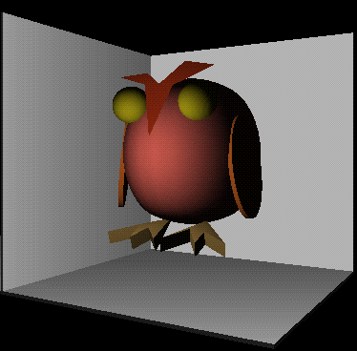
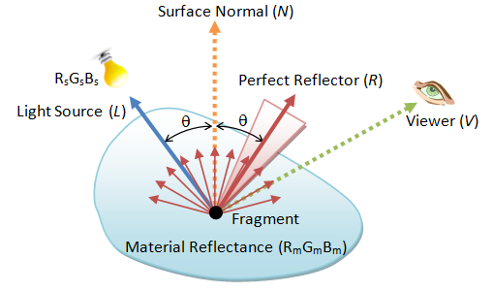
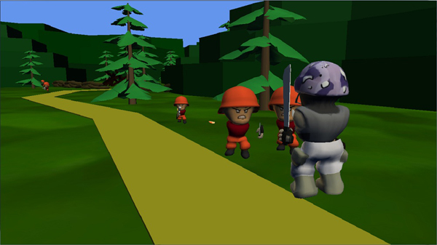
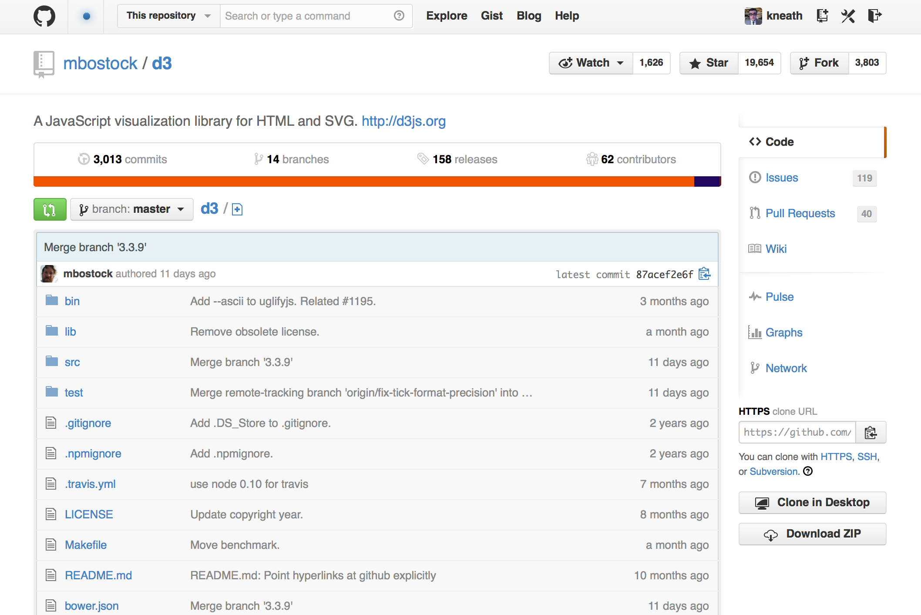
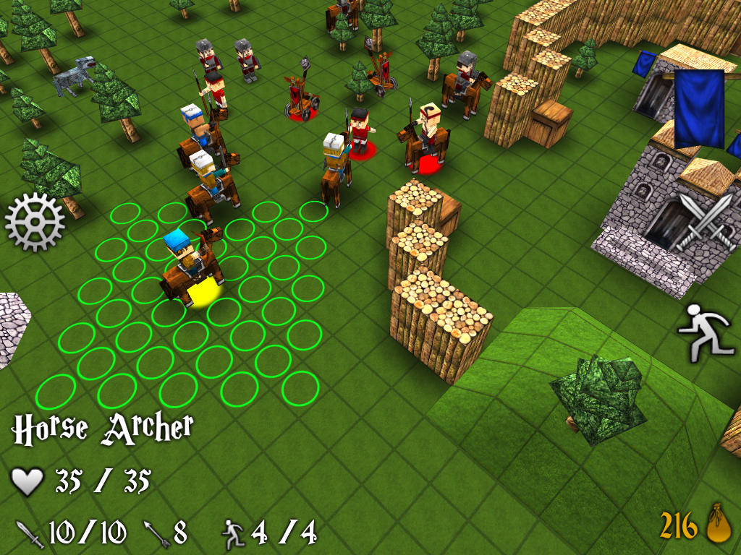
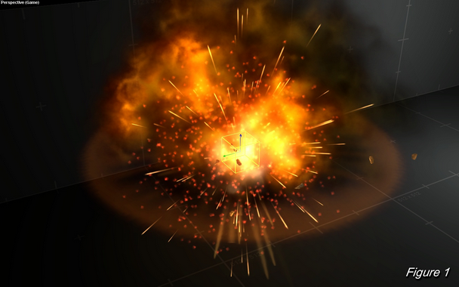
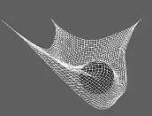
Lighting – How to
Advanced Games Programming (CGP600)

Slide 2
Creating Ambient & Directional Light
struct POS_COL_TEX_NORM_VERTEX
{
XMFLOAT3 Pos;
XMFLOAT4 Col;
XMFLOAT2 Texture0;
XMFLOAT3 Normal;
};
Add a normal variable to the vertex structure

Slide 3
Creating Ambient & Directional Light
VOut VertShader( float4 position: POSITION,
float4 color: COLOR,
float2 texcoord: TEXCOORD,
float3 normal: NORMAL)
In the shader, add the 3-float normal to the vertex shader param list

Slide 4
Adding Ambient & Directional Light
XMVECTOR g_directional_light_shines_from;
XMVECTOR g_directional_light_colour;
XMVECTOR g_ambient_light_colour;
In the globals section, add vectors for:
directional light
directional light colour
ambient light colour

Slide 5
Adding Ambient & Directional Light
g_directional_light_shines_from = XMVectorSet(0.0f, 0.0f, -1.0f, 0.0f);
g_directional_light_colour = XMVectorSet(0.0f, 1.0f, 0.0f, 0.0f);
g_ambient_light_colour = XMVectorSet(0.1f, 0.1f, 0.1f, 1.0f);
Set vector values near start of
RenderFrame()
Using XMVectorSet() function

Slide 6
Adding Ambient & Directional Light
g_directional_light_shines_from = XMVectorSet(0.0f, 0.0f, -1.0f, 0.0f);
g_directional_light_colour = XMVectorSet(0.0f, 1.0f, 0.0f, 0.0f);
g_ambient_light_colour = XMVectorSet(0.1f, 0.1f, 0.1f, 1.0f);
Direction of light is coming from negative z direction, shining along positve z axis.

Slide 7
Adding Ambient & Directional Light
g_directional_light_shines_from = XMVectorSet(0.0f, 0.0f, -1.0f, 0.0f);
g_directional_light_colour = XMVectorSet(0.0f, 1.0f, 0.0f, 0.0f);
g_ambient_light_colour = XMVectorSet(0.1f, 0.1f, 0.1f, 1.0f);
Colour of directional light is green:
r = 0.0f, g = 1.0f, b = 0.0f

Slide 8
Adding Ambient & Directional Light
g_directional_light_shines_from = XMVectorSet(0.0f, 0.0f, -1.0f, 0.0f);
g_directional_light_colour = XMVectorSet(0.0f, 1.0f, 0.0f, 0.0f);
g_ambient_light_colour = XMVectorSet(0.1f, 0.1f, 0.1f, 1.0f);
Ambient light colour is dark grey:
r = 0.1f, g = 0.1f, b = 0.1f

Slide 9
Adding Ambient & Directional Light
g_directional_light_shines_from = XMVectorSet(0.0f, 0.0f, -1.0f, 0.0f);
g_directional_light_colour = XMVectorSet(0.0f, 1.0f, 0.0f, 0.0f);
g_ambient_light_colour = XMVectorSet(0.1f, 0.1f, 0.1f, 1.0f);
Keep ambient colour dark to avoid drowning out other light sources

Slide 10
Adding Ambient & Directional Light
struct CONSTANT_BUFFER0
{
XMMATRIX WorldViewProjection ; // 64 bytes
XMVECTOR directional_light_vector; // 16 bytes
XMVECTOR directional_light_colour; // 16 bytes
XMVECTOR ambient_light_colour; // 16 bytes
}; // TOTAL SIZE = 112 bytes
Update constant buffer
(Keep an eye on your packing and your variable ordering)

Slide 11
Adding Ambient & Directional Light
constant_buffer_desc.ByteWidth = 112;
// MUST be a multiple of 16, calculate from CB struct
Update constant buffer description with the structure’s new byte size

Slide 12
Adding Ambient & Directional Light
cbuffer CB0
{
matrix WVPMatrix; // 64 bytes
float4 directional_light_vector; // 16 bytes
float4 directional_light_colour; // 16 bytes
float4 ambient_light_colour; // 16 bytes
} // TOTAL SIZE = 112 bytes
Match the changes to the constant buffer struct on the shader side.

Slide 13
Adding Ambient & Directional Light
XMMATRIX transpose;
CONSTANT_BUFFER0 cb0_values;
transpose = XMMatrixTranspose(world); // model world matrix
cb0_values.directional_light_colour = g_directional_light_colour;
cb0_values.ambient_light_colour = g_ambient_light_colour;
cb0_values.directional_light_vector = XMVector3Transform(g_directional_light_shines_from, transpose);
cb0_values.directional_light_vector = XMVector3Normalize( cb0_values.directional_light_vector );
Update the constant buffer with the new lighting data.

Slide 14
Adding Ambient & Directional Light
XMMATRIX transpose;
CONSTANT_BUFFER0 cb0_values;
transpose = XMMatrixTranspose(world); // model world matrix
cb0_values.directional_light_colour = g_directional_light_colour;
cb0_values.ambient_light_colour = g_ambient_light_colour;
cb0_values.directional_light_vector = XMVector3Transform(g_directional_light_shines_from, transpose);
cb0_values.directional_light_vector = XMVector3Normalize( cb0_values.directional_light_vector );
Correct model lighting requires lights to be set up before models are drawn

Slide 15
Adding Ambient & Directional Light
XMMATRIX transpose;
CONSTANT_BUFFER0 cb0_values;
transpose = XMMatrixTranspose(world); // model world matrix
cb0_values.directional_light_colour = g_directional_light_colour;
cb0_values.ambient_light_colour = g_ambient_light_colour;
cb0_values.directional_light_vector = XMVector3Transform(g_directional_light_shines_from, transpose);
cb0_values.directional_light_vector = XMVector3Normalize( cb0_values.directional_light_vector );
What’s transpose?

Slide 16
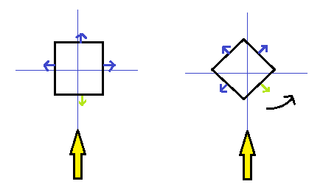
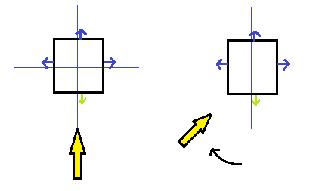
Adding Ambient & Directional Light
Transposing:
Move the light matrix rather than the model vertices:
Moving the model
Moving the light

Slide 17
Adding Ambient & Directional Light
Transposing:
More efficient for vertex shader:
move one light source
vs
moving (potentially) thousands of verts in a complex model.

Slide 18
Adding Ambient & Directional Light
Transposing:
Handy function will do the complex maths for us:
XMMatrixTranspose()
Performs opposite rotational transforms of a matrix in reverse order

Slide 19
Adding Ambient & Directional Light
XMMATRIX transpose;
CONSTANT_BUFFER0 cb0_values;
transpose = XMMatrixTranspose(world); // model world matrix
cb0_values.directional_light_colour = g_directional_light_colour;
cb0_values.ambient_light_colour = g_ambient_light_colour;
cb0_values.directional_light_vector = XMVector3Transform(g_directional_light_shines_from, transpose);
cb0_values.directional_light_vector = XMVector3Normalize( cb0_values.directional_light_vector );

Slide 20
Lighting the vertices
VOut VShader(float4 position: POSITION, float4 color: COLOR, float2 texcoord: TEXCOORD, float3 normal: NORMAL)
{
VOut output;
output.position = mul(WVPMatrix, position);
float diffuse_amount = dot(directional_light_vector,normal);
diffuse_amount = saturate(diffuse_amount);
output.color = ambient_light_colour + (directional_light_colour * diffuse_amount);
output.texcoord = texcoord;
return output;
}
Update the vertex shader

Slide 21
Lighting the vertices
…code…
float diffuse_amount = dot(directional_light_vector, normal);
diffuse_amount = saturate(diffuse_amount);
output.color = ambient_light_colour + (directional_light_colour * diffuse_amount);
…more code…
diffuse amount calculated from dot between light vector and normal
(essentially, light intensity)

Slide 22
Lighting the vertices
…code…
float diffuse_amount = dot(directional_light_vector, normal);
diffuse_amount = saturate(diffuse_amount);
output.color = ambient_light_colour + (directional_light_colour * diffuse_amount);
…more code…
Saturate() function clamps value between 0.0f and 1.0f

Slide 23
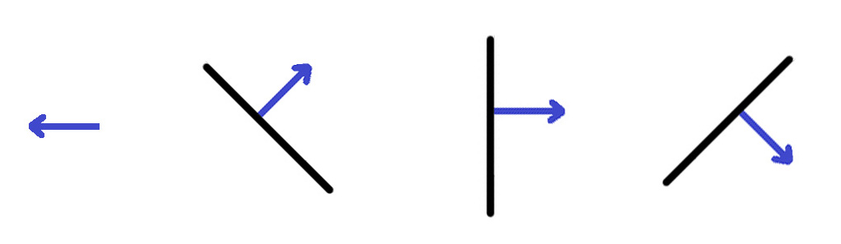
Lighting the vertices
…code…
float diffuse_amount = dot(directional_light_vector, normal);
diffuse_amount = saturate(diffuse_amount);
output.color = ambient_light_colour + (directional_light_colour * diffuse_amount);
…more code…
why clamp?
dp = -0.5f
dp = -0.5f
dp = -1.0f
Towards light
Negative dot product can cause lighting problems on “unlit” faces

Slide 24
Lighting the vertices
…code…
float diffuse_amount = dot(directional_light_vector, normal);
diffuse_amount = saturate(diffuse_amount);
output.color = ambient_light_colour + (directional_light_colour * diffuse_amount);
…more code…
Final colour =
ambient light colour +
(diffuse amount (“light intensity”) *
directional light colour)

Slide 25
Using Lighting Colour in the Pixel Shader
return color * texture0.Sample(sampler0, texcoord);
Update pixel shader to use lighting info.
final colour =
texture sample colour *
lighting colour

